Slide 1

Online Voting system(OVS)

Slide 2

Team members:
Presented by:
Arpit Jaiswal
Sandeep .
Harini Shree
Utkarsh Srivastav
Anush Piriyah Ghanesh

Slide 3
Introduction:
“ONLINE VOTING SYSTEM” is an online voting technique. In this system people who have citizenship of India and whose age is above 18 years of age and any sex can give his\her vote online without going to any physical polling station.
There is a database which is maintained in which all the names of voters with complete information is stored.
The system Administrator registers the voters on a special site of the system visited by him only by simply filling a registration form to register voter.
After registration, the voter is assigned a secret Voter ID with which he/she can use to log into the system and enjoy services provided by the system such as voting. If invalid/wrong details are submitted, then the citizen is not registered to vote.

Slide 4
Objective:
The specific objectives of the project include:
Reviewing the existing/current voting process or approach in India.
Coming up with an automated voting system in India.
Implementing an automated/online voting system.
Validating the system to ensure that only eligible voters are allowed to vote.

Slide 5
Purpose:
Some main purpose of OVS:
Provision of improved voting services to the voters through fast, timely and convenient voting.
Reduction of the costs incurred by the Indian Electoral Commission during voting time in paying the very many clerks employed for the sake of the success of the manual system.
Online Voting System (OVS) will require being very precise or cost cutting to produce an effective election management system.

Slide 6
Requirements:
Windows version 7+
Front end Software: Html , CSS , java script, Angular.
Backend software: Java, Spring Boot, Spring Data JPA, Database(Oracle).

Slide 7
Project scope:
Our project aims to safe and easy handling of OVS. i.e. we have made a computerized process to Vote online.
It satisfies the admin.
It is easy, Safe and Secure.
It is easy to operator.
Have a good user interface.
It saves time and function faster.
We have tried to develop safe and secure software with above mentioned specifications.

Slide 8


Used Tools and technologies:
Frontend: Html , CSS, Java script and Angular.
Back end: Spring tool suite
Database(Oracle).
VS Code
Online tools:
Eclipse
Word pad
Notepad

Slide 9
Modules:
Our system has four main modules as mentioned below: -
Register Module:
In this module the new users can create new account in our web-application.
Login Module:
In this module the user and admin can enter their login credentials and they will be redirected to their respective pages. Only admin can login to create the election.
The user will get only those privileges that are given to the user for which one has registered.
Voter Module:
Voter can vote from the list of available parties.
Result Module:
In this module admin can check and update the results of the elections.

Slide 10

Frontend [language used]:
HTML
CSS
JAVA SCRIPT
Angular

Slide 11



Backend [language used]:
JAVA
SPRING BOOT
SPRING DATA JPA

Slide 12

DATABASE:
Oracle SQL

Slide 13
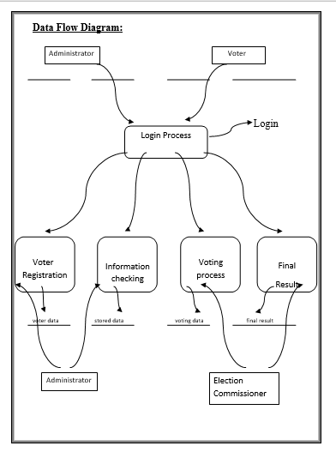
Data flow diagram:

Slide 14
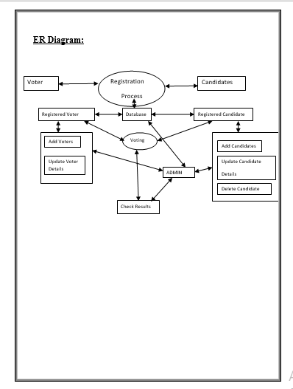
E-r diagram:

Slide 15
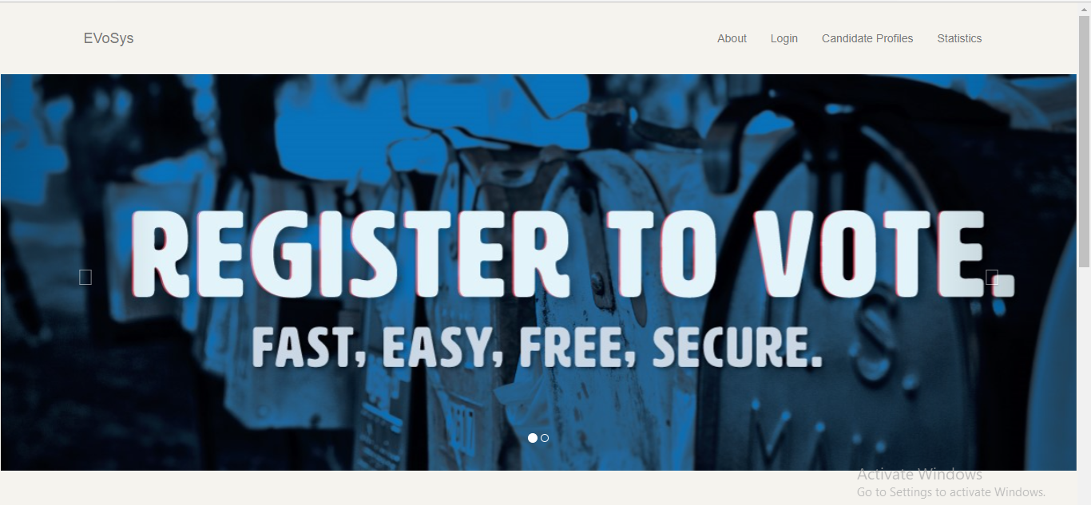
Home page:

Slide 16
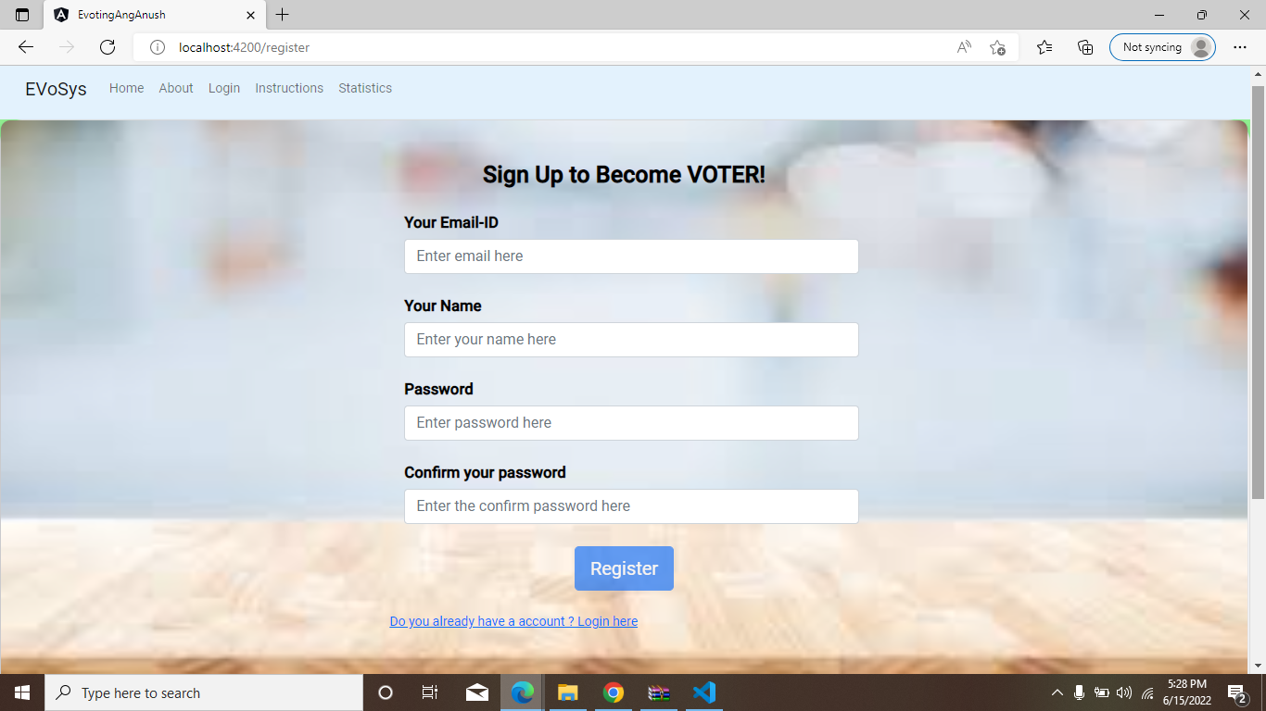
Register Page :-

Slide 17
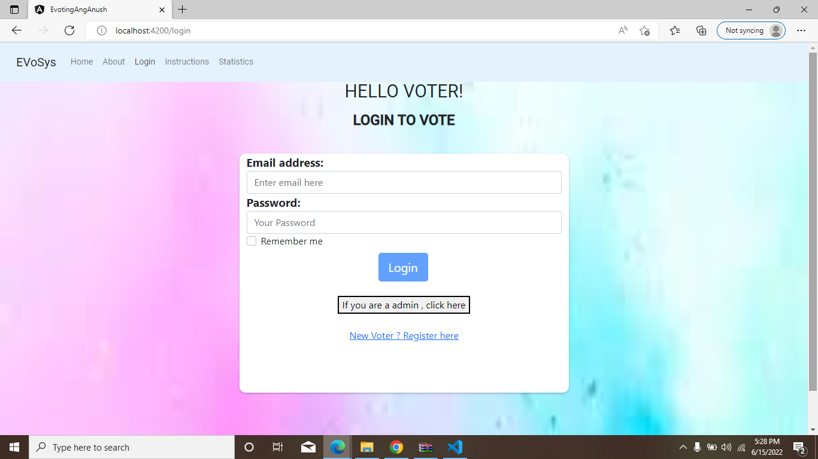
Login page of voter :-

Slide 18
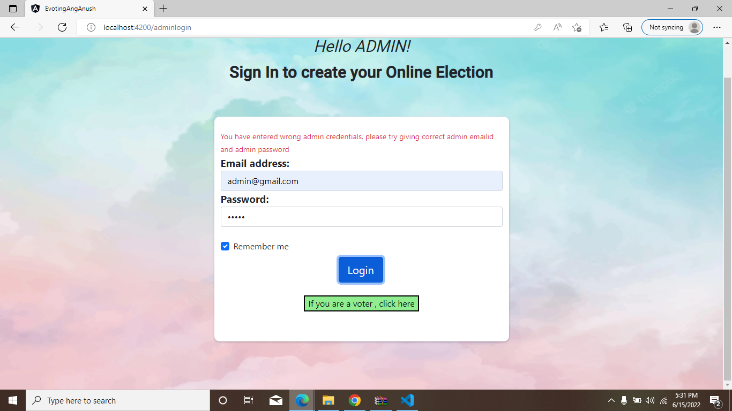
Login page of admin :-

Slide 19
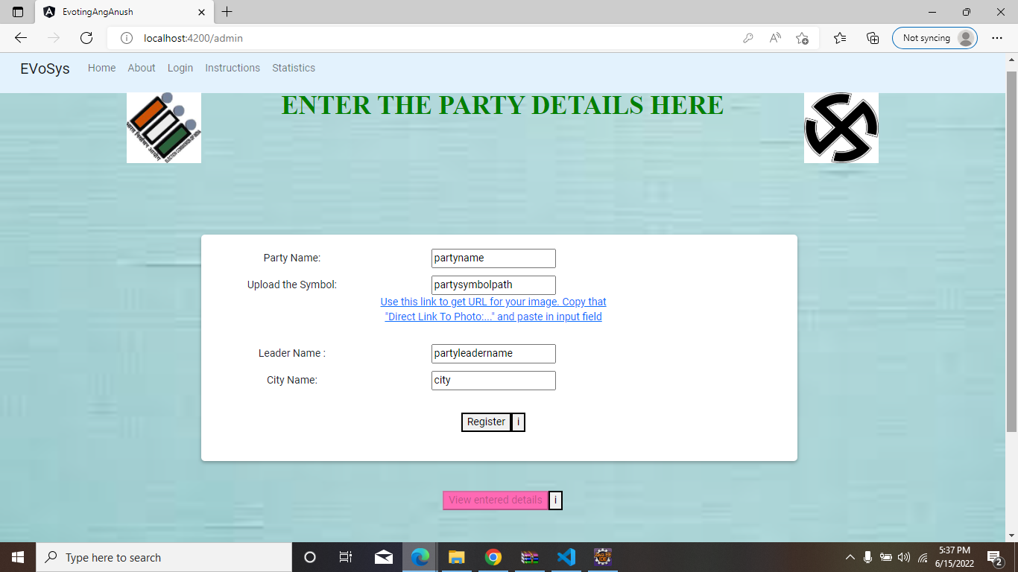
Party detail page :-

Slide 20
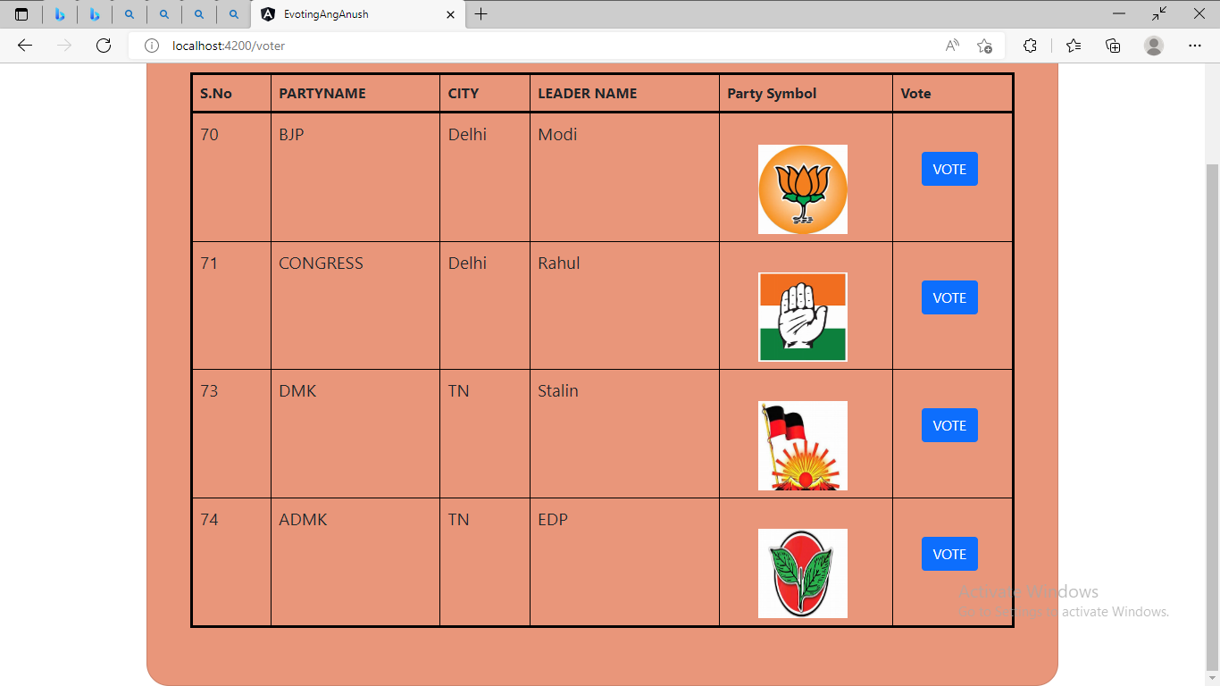
Voting page :-

Slide 21
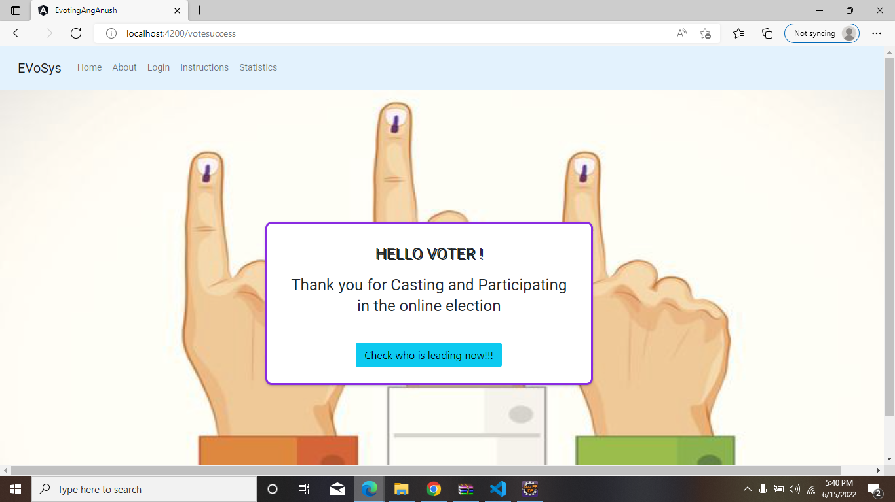
Thank-you page for voter :-

Slide 22
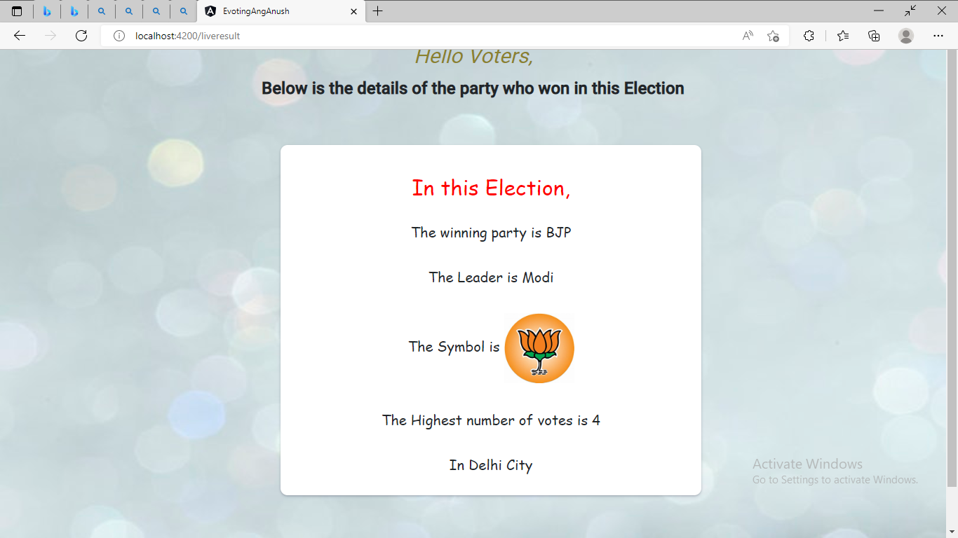
Details of leading party’s page :-

Slide 23

Logout page :-

Slide 24
Conclusion and future scope:
Future scope:
This application involves almost all the basic features of Voting.
The future implementation will be help for students, Handicap and Old age people.
Conclusion:
This Online Voting system will manage the Voter’s information by which voter can login and use his voting rights. The system will incorporate all features of Voting system. It provides the tools for maintaining voter’s vote to every party and it count total no. of votes of every party. There is a DATABASE in which all the names of voter with complete information is stored.

